Slide 1
GM Moving Conference
2024
Embedding physical activity in health and care

Slide 2
We are all designed to move.....
Moving matters to all of us​
We need to design moving into everyday life We all have a role to play
Notes:
Modern environment and social factors makes this harder, and contributes to leading more sedentary lifestyles – exacerbated during covid.
To address this and create a social reality where everyone has the opportunities and ability to move requires a change in how we perceive, understand, and talk about movement and health.

Slide 3
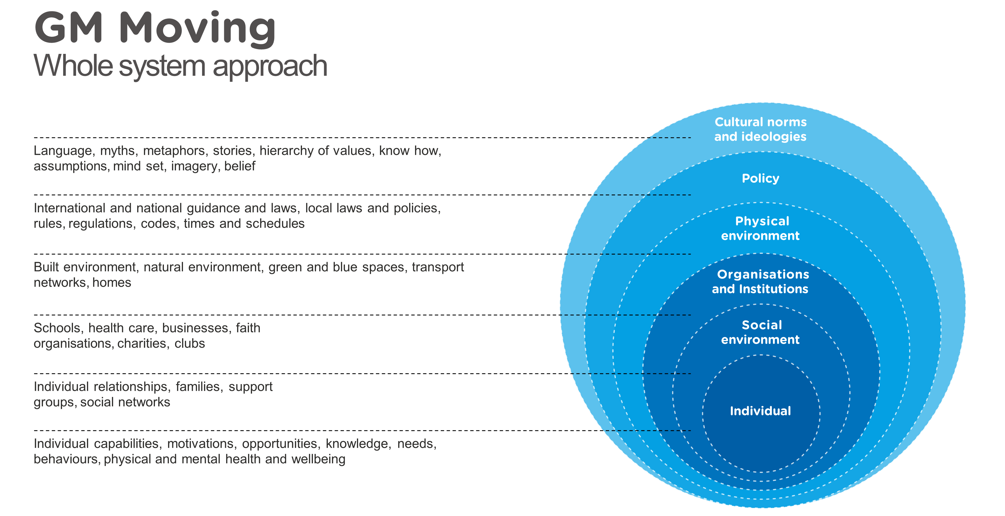
Notes:
Quick fixes aren’t the solution. We’re talking about behaviour and culture change which is no weekend job.
GM Moving whole system approach – different solution to enabling healthy, happy lives.
Contribution of PA to health often underrepresented despite physical inactivity being one of the main causes of ill health. But lots of evidence of the benefits movement has to the health of individuals, communities, societies, environment, economy, and cultures

Slide 4
Active Practices
Free charter that recognises practices taking dedicated steps to boost staff and patient health and wellbeing
Co-developed by The Royal College of GPs and Sport England, and focuses on increasing movement and reducing sedentary behaviour
E.g. walking meetings, cycle to work scheme, standing spaces in waiting rooms, signposting to stairs, posters re local groups
Benefits include…
Patients managing their own health
Improved staff and patient wellbeing
Improved physical health conditions
Collaboration with local community and PCN
Sharing learnings with others
Meeting components of Quality & Outcomes Framework
Notes:
Andrew

Slide 6
Matt Berry
Health Coach
Urban Village Medical Practice
Notes:
Andrew

Slide 7
Dr Ed Appleby,
Sport & Exercise Medicine Specialty Registrar edward.appleby@nhs.net
Peter Locke,
Public Health Strategic Manager peter.locke@salford.gov.uk

Slide 8
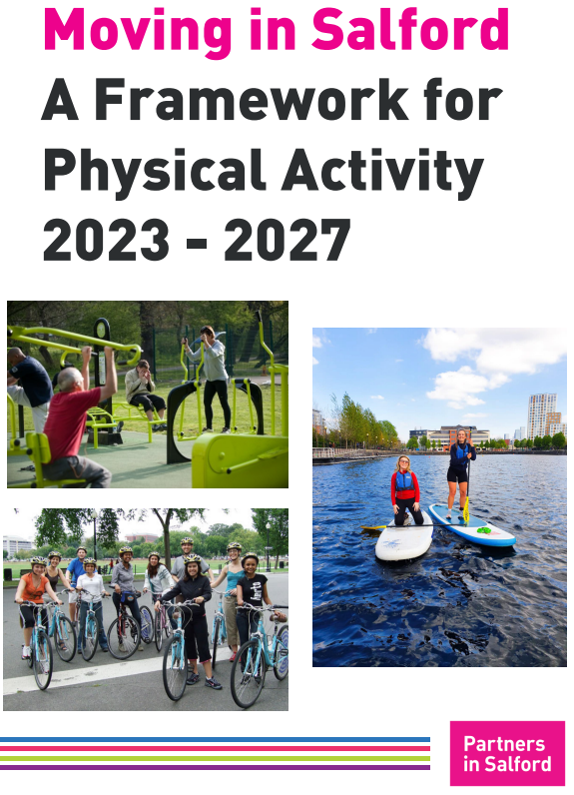

Slide 9
Increasing physical activity in patients and staff
Reducing sedentary behaviour in patients and staff
Partnering with a local physical activity provider to support the practice to get more people active

Slide 10
Key Enablers – Why did it go well?
Integrated with and informed by wider, Public Health convened, whole systems strategy
Enhanced capacity and expert peer influence
Systems thinking and collaboration
Pre-existing relationships and influence with senior people at the Health and Wellbeing Board, Locality Board and within the Eccles and Irlam PCN
Simultaneous place-based work on PCN footprint to develop the wider system, engaging with cross sector partners to develop the offer that practices have available and the knowledge of this

Slide 11
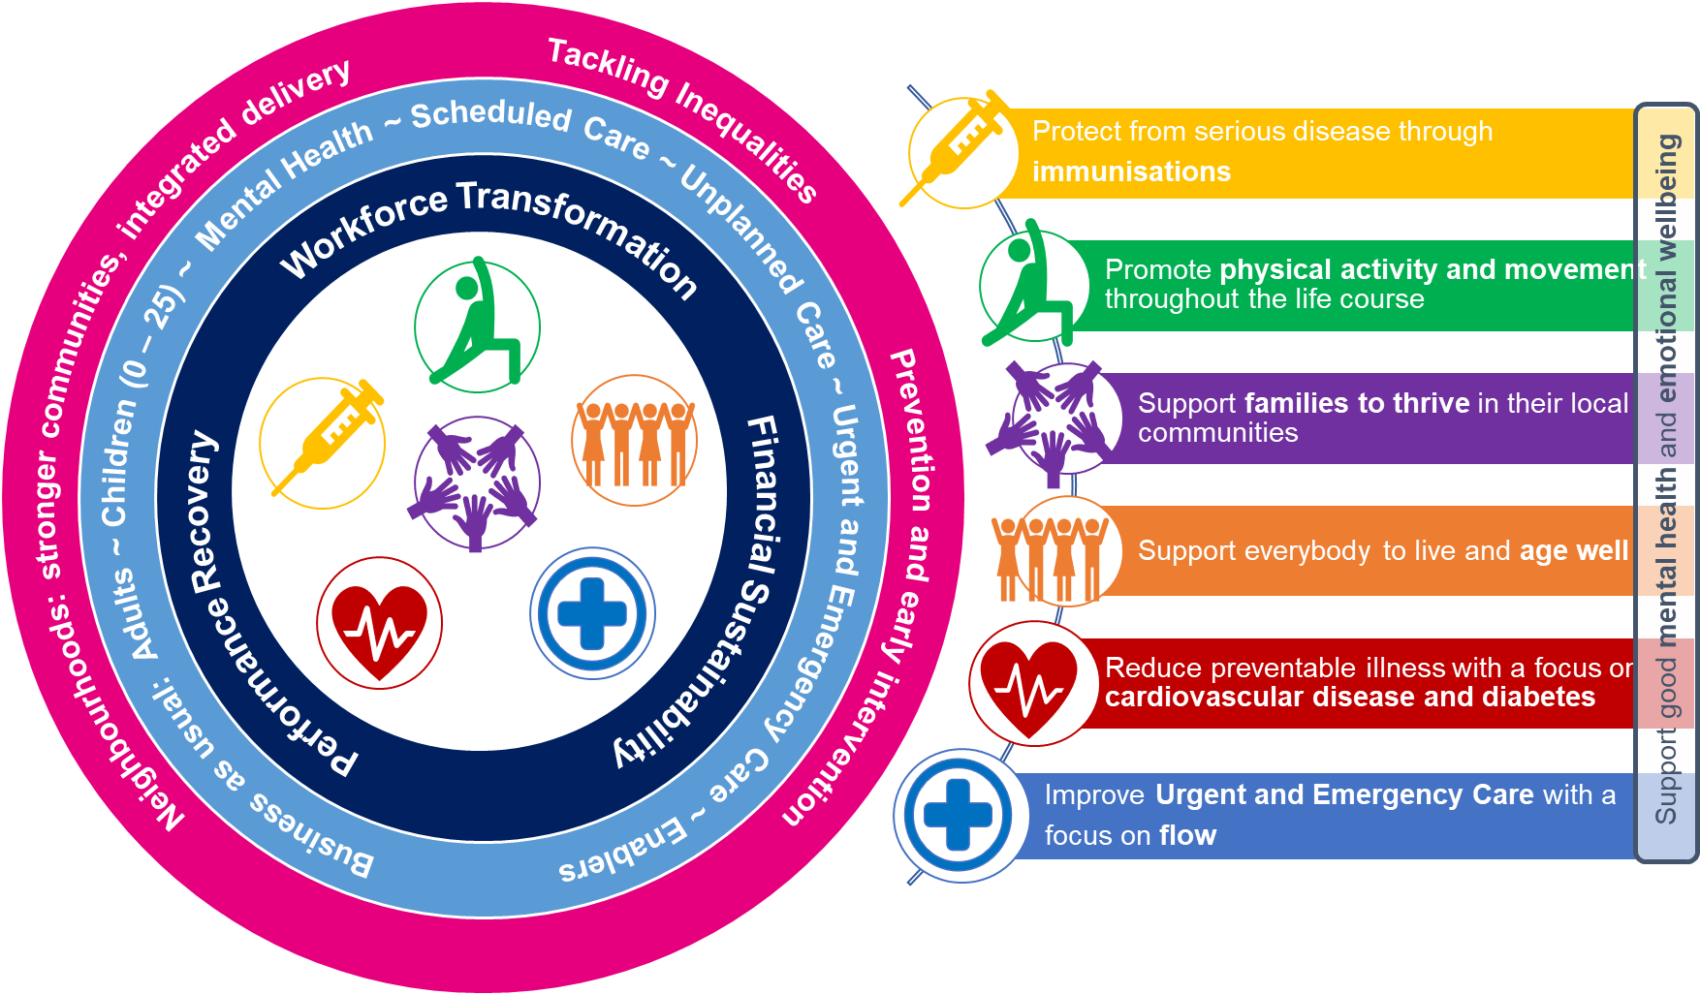
Integrated Care Partnership Priority for 2024/25 -
Promote Physical Activity and Movement across the Life Course

Slide 12
Health and Care: call to action
Specifically related to ‘health and care’ in Moving in Salford is Priority Ten and good progress has been made in 2023/24.
However, with increased precedence given to Movement and Physical Activity by health leaders in 2024/25, progress should be accelerated
We NEED even more health and care colleagues at all levels to take leadership on this, to ensure the role of 'movement' is recognised, advocated for and embedded in practice across the health and care sector

Slide 13
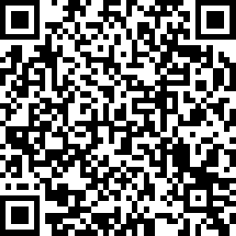
Give your feedback on the conference
What next?
GM Walking Festival in May
PACC training (healthcare staff)
Better Conversations workshops (non-healthcare staff)
Contact imogen@gmmoving.co.uk for a chat

